Slide 1

CUI Abbottabad
Department of Computer Science
Object Oriented Programming
Lecture No. 8
Memory Allocation to Objects , Finalize() method and Garbage Collection
COMSATS University Islamabad, Abbottabad Campus

Slide 2
Memory Allocation to Objects
Objects are allocated by specifying the new operator with an object constructor. A constructor is a special method with the same name as its class and no return type. It's called when a new class instance is created, which gives the class an opportunity to set up the object for use.
In JAVA , when we allocate the object using new(), the object is allocated on Heap, otherwise on Stack if not global or static.
When we only declare a variable of a class type, only a reference is created (memory is not allocated for the object). To allocate memory to an object, we must use new(). So the object is always allocated memory on the heap.

Slide 3
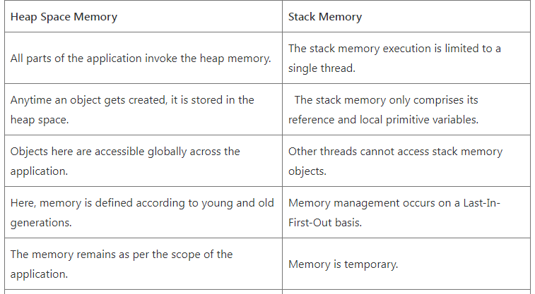
Memory Allocation to Objects contd.
Memory allocation in java can be defined as a process of assigning storage to java programs or services. Memory allocation in java is done in JVM (Java Virtual Machine) memory, broadly divided into a heap and non-heap memory.
Heap Space and Stack Memory: Fundamental Differences

Slide 4
Example: Memory Allocation to Objects
class A{
int id;
String name;
int[] marks = new int[5];
void get(){
Scanner s = new Scanner(System.in);
id = s.nextInt();
name = s.next();
for(int i=0; i<3; i++){
marks[i] = s.nextInt();
}
}//get
}
class Marks{
public static void main(String[] a1){
A ob = new A(); //Objects are allocated dynamically
ob.get();
}
}//end of main

Slide 5
Finalize() method in Java
finalize() method in Java is a method of the Object class that is used to perform cleanup activity before destroying any object.
It is called by Garbage collector before destroying the objects from memory. finalize() method is called by default for every object before its deletion.
This method helps Garbage Collector to close all the resources used by the object and helps JVM in-memory optimization.

Slide 6
Example 1: Use of Finalize method in Java
class A{
public static void main(String[] args) {
String str = "Hello COMSATS!";
str = null; //eligible for garbage collection
System.gc();
System.out.println("Garbage collector is called");
}
@Override
protected void finalize() {
System.out.println("Finalize method is called .");
}
}// end of A class
Output: Garbage collector is called

Slide 7
Example 2: Use of Finalize method in Java
class Student{
public static void main(String[] args){
Student s1 = new Student();
s1 = null; //s1 object is eligible for garbage collection
System.gc();
System.out.println("Garbage collector is called");
}
@Override
protected void finalize(){
System.out.println("Finalize method is called.");
}
}
Output:
Garbage collector is called
Finalize method is called.

Slide 8
Garbage Collection
As long as an object is being referenced, the JVM considers it alive. Once an object is no longer referenced and therefore is not reachable by the application code, the garbage collector removes it and reclaims the unused memory.
Java garbage collection is an automatic process. Automatic garbage collection is the process of looking at heap memory, identifying which objects are in use and which are not, and deleting the unused objects.
A referenced object, means that some part of your program still maintains a pointer to that object.
An unused or unreferenced object is no longer referenced by any part of your program. So the memory used by an unreferenced object can be reclaimed. The programmer does not need to mark objects to be deleted explicitly. The garbage collection implementation lives in the JVM.

Slide 9
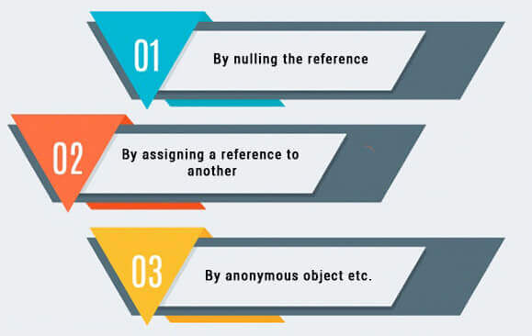
Garbage Collection contd.
How can an object be unreferenced ?
There are three approaches to unreferenced objects

Slide 10
Garbage Collection contd.
By nulling a reference:
Student ob = new Student();
ob = null;
By assigning a reference to another:
Student ob1 = new Student();
Student ob2 = new Student();
ob1 = ob2; //now the first object referred by e1 is available for garbage
//collection
By anonymous object:
new Student();

Slide 11
Garbage Collection contd.
Request for Garbage Collection
Once we made objects eligible for garbage collection, we can not expect when JVM runs Garbage Collector. It may not destroy immediately by the garbage collector. Whenever JVM runs the Garbage Collector program, then only the object will be destroyed.
So, we can request JVM in the following two ways:
1. Using System.gc() method :
System class contain static method gc() for requesting JVM to run Garbage Collector.
2. Using Runtime.getRuntime().gc() method:
Runtime class allows the application to interface with the JVM in which the application is running. Hence by using its GC() method, we can request JVM to run the Garbage Collector.

Slide 12
Garbage Collection contd.
Example: Garbage Collection Demo
class Garbage{
public void finalize(){
System.out.println("Garbage Collection performed by JVM");
}
public static void main (String args[]){
Garbage ob1 = new Garbage();
Garbage ob2 = new Garbage();
ob1 = null;
ob2 = null;
System.gc();
}
}//
Output:
Garbage Collection performed by JVM
Garbage Collection performed by JVM

